Slide 1
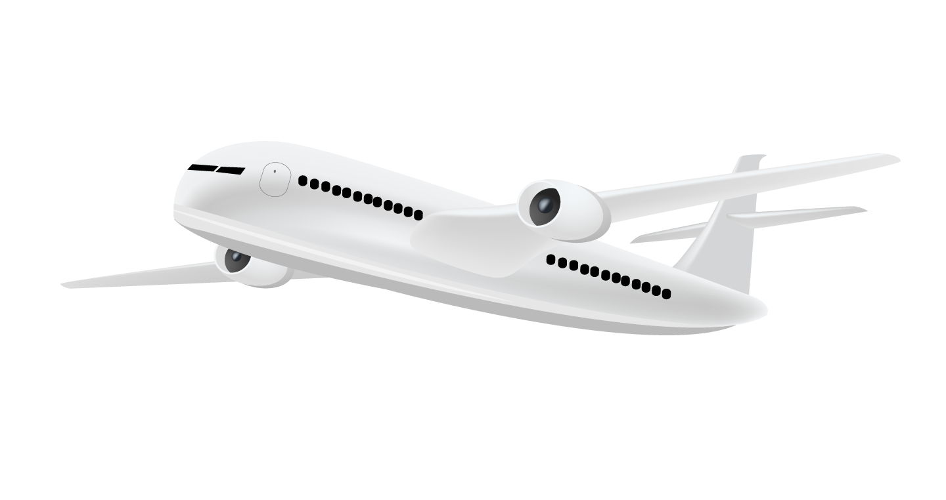
Travel Buddy
Travel Smart. Travel Fast.

Slide 2
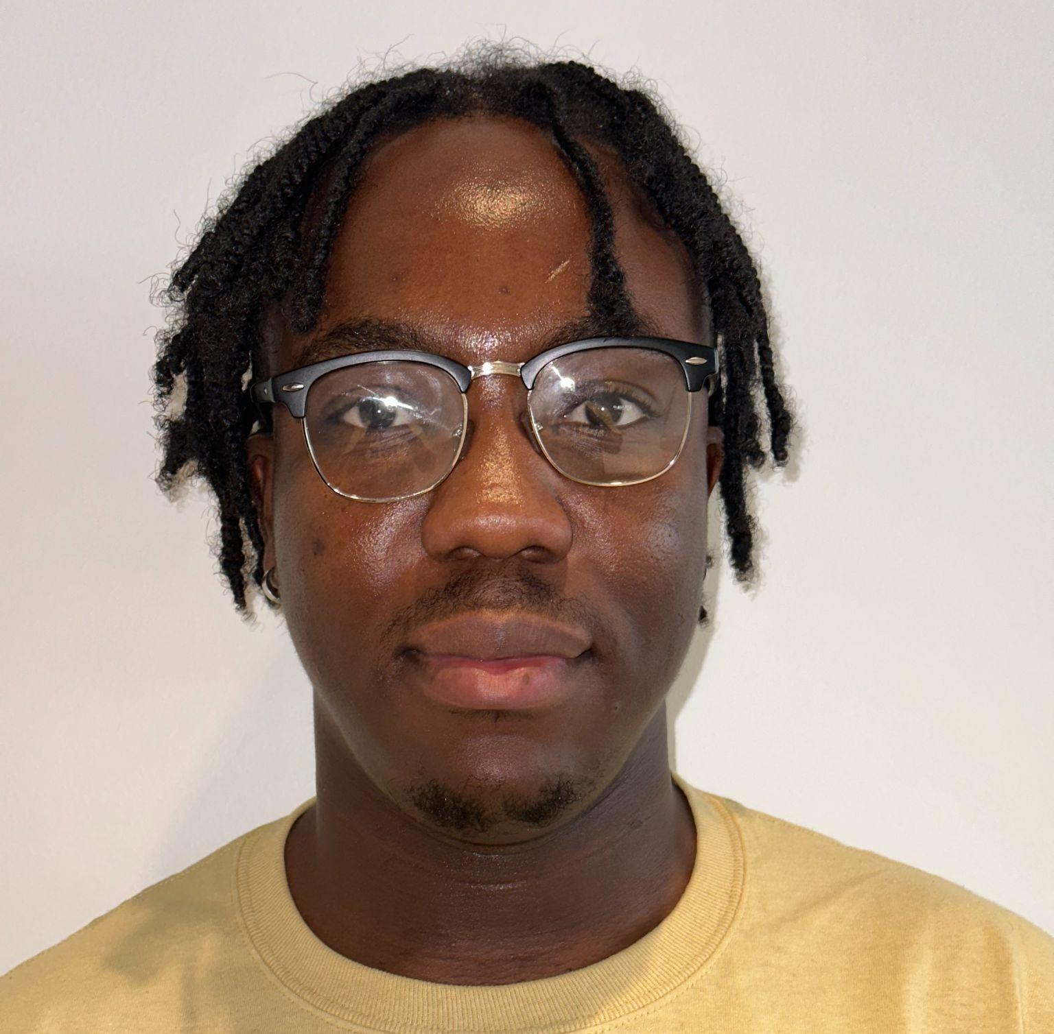
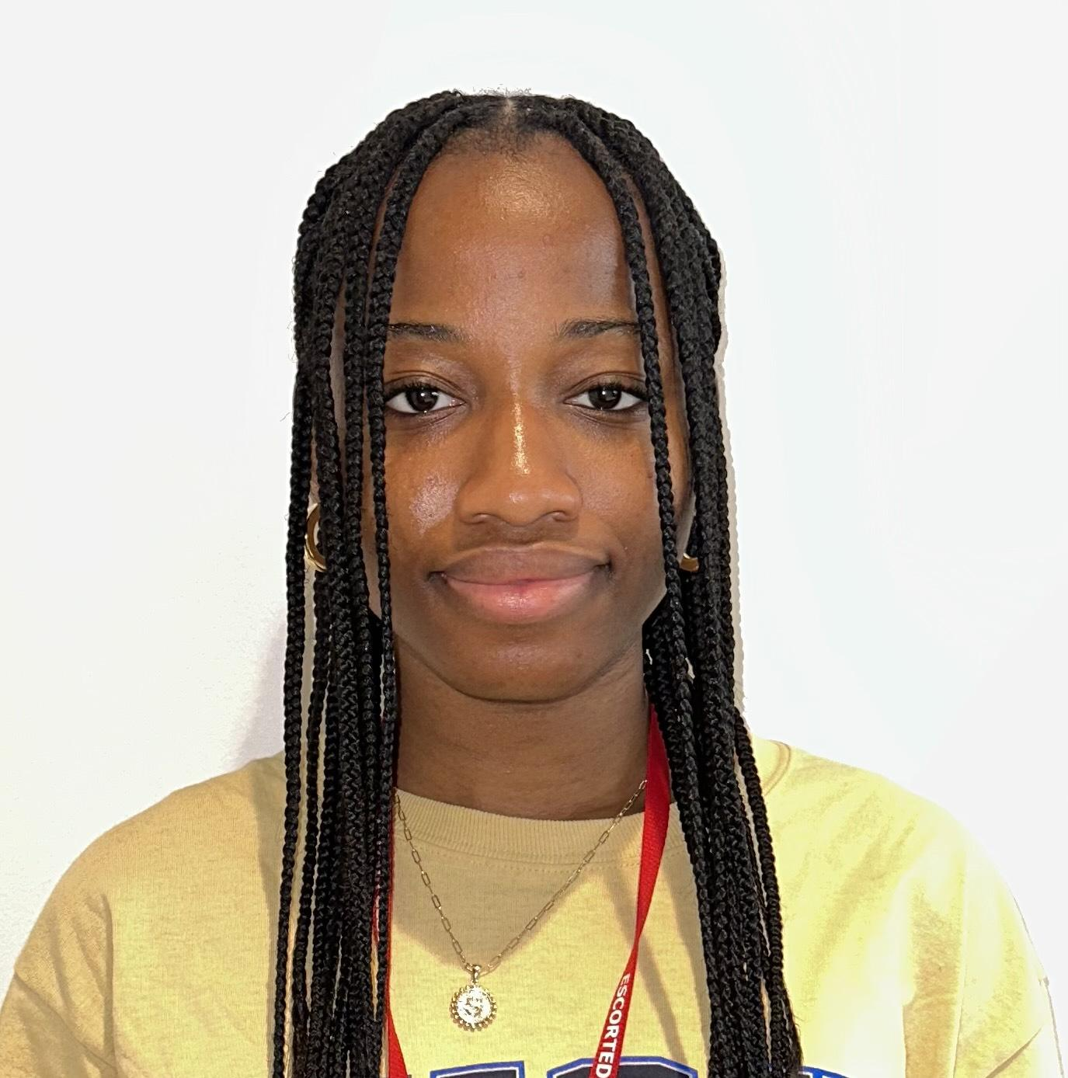

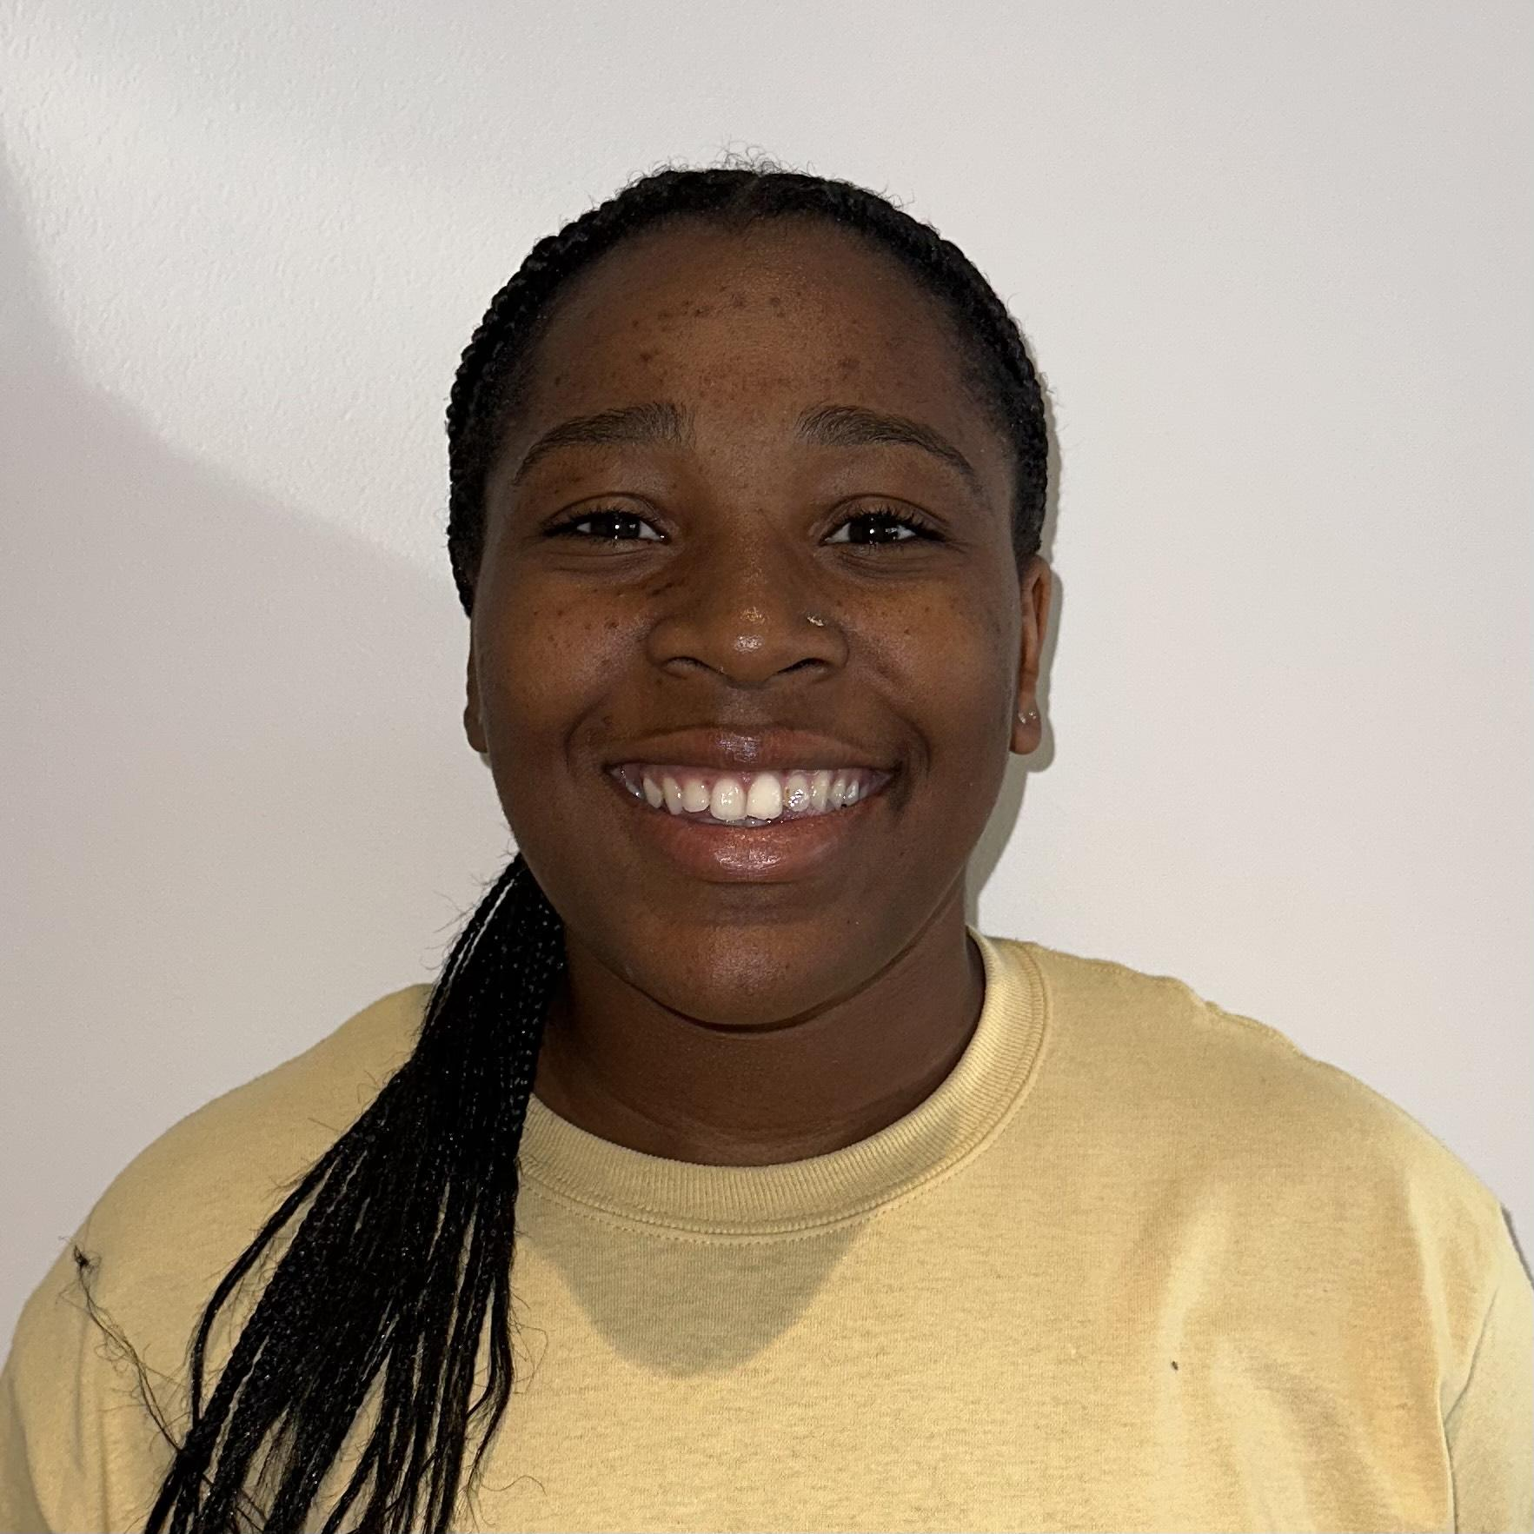

Our Team: BeFisk
Caleb
Sopuruchi
Aayush
Asha
Aminu
Senior
Computer Science
Junior
Art & Design
Junior
Computer Science
Junior
Computer Science
Senior
Computer Science

Slide 3
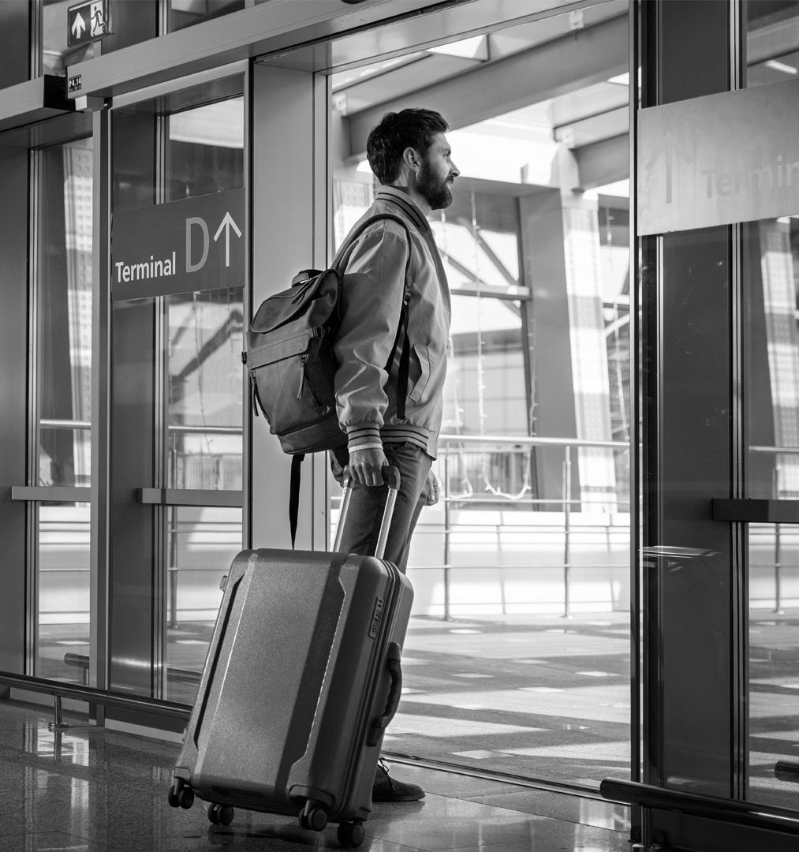
Problem Statement
Current boarding process is very ambiguous, leading to congestion at the ticket counter.
Notes:
We have observed that the current boarding process and resources aren’t meeting the needs of customers by providing a clear guide. Which is leaving customers confused about when and where they should go. Which in turn creates unnecessary strain on resources in the airport such as ticketing booths.

Slide 4
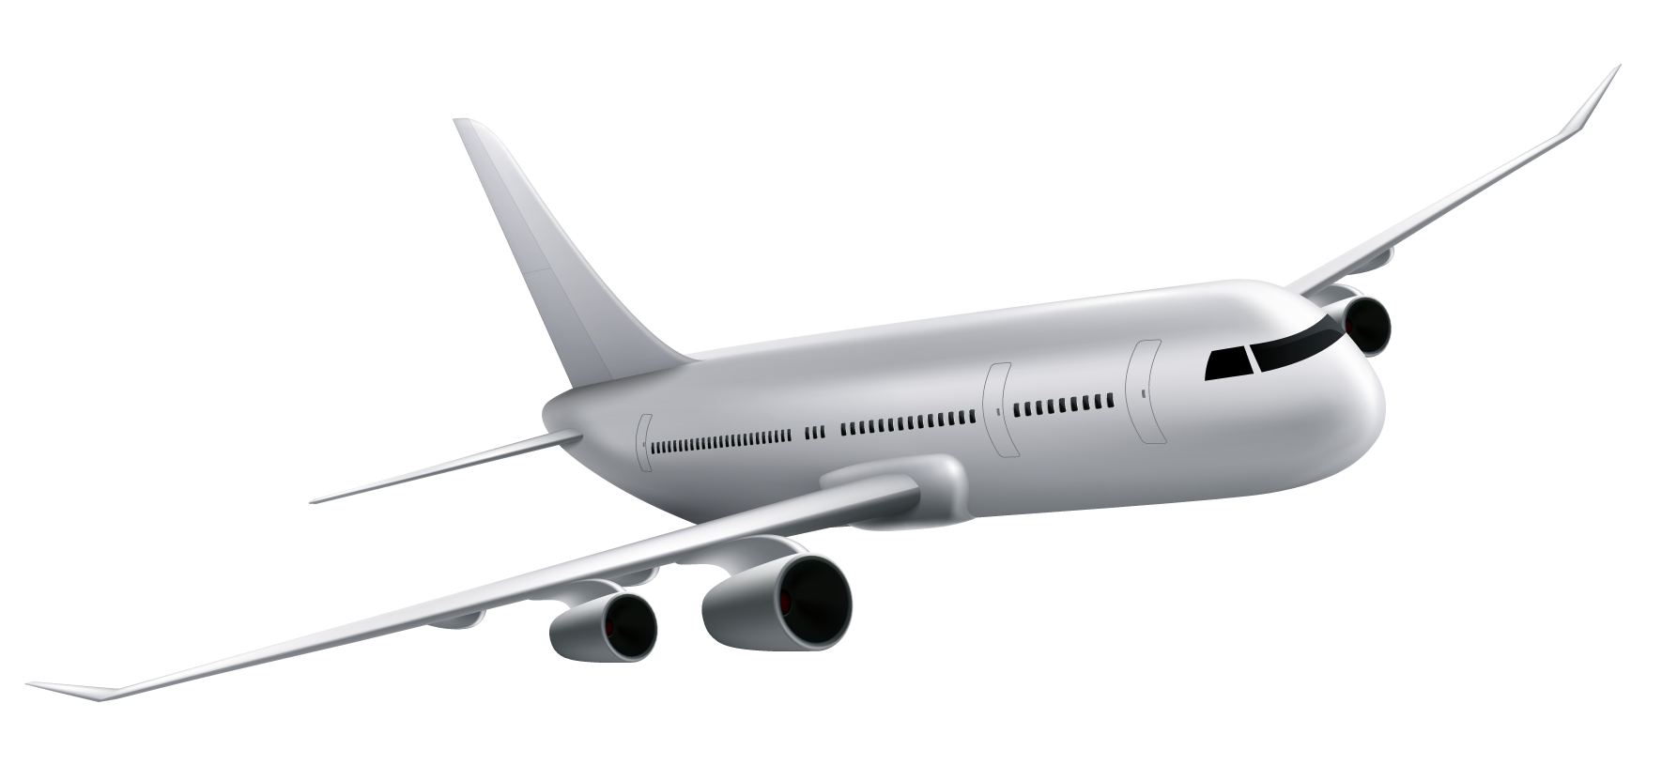
What Is Travel Buddy?

Slide 5
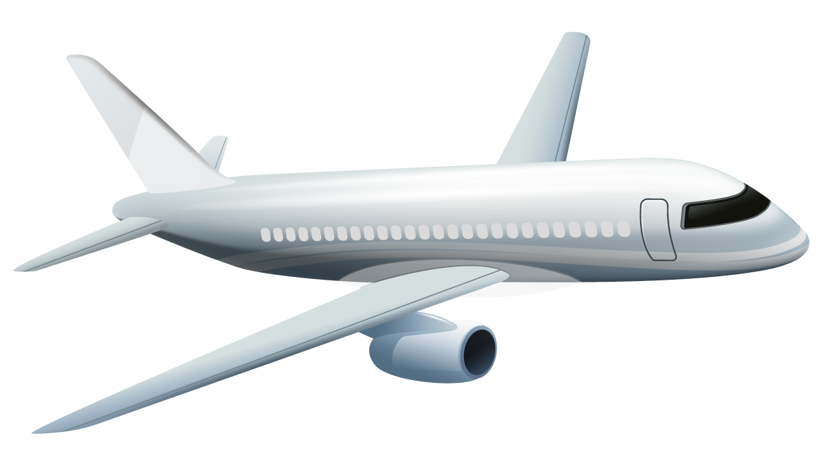
Travel Buddy
01
02
03
Information Center
Roadmap
Baggage Scan
Brings all boarding services into one location
Clearly maps out the boarding process
Allows travellers to scan bags and find out whether or not they are carry-ons or checked bags
Notes:
Travel Buddy is a Virtual Assitant that does

Slide 6
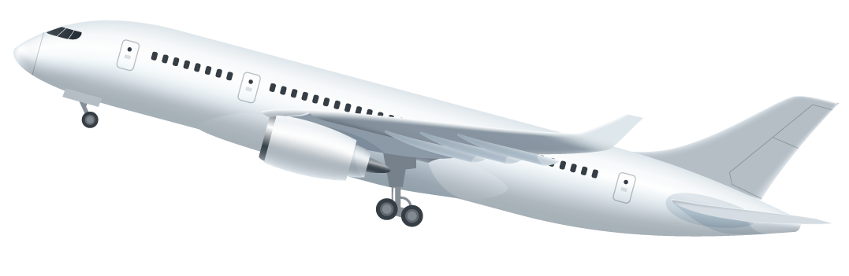
Who Can Use Travel Buddy
Notes:
Travel Buddy is for aa and non aa members. Frequent flyers and first timers. Travel Buddy is for all travellers to assist them in improving they’re airport experience.

Slide 7

Notes:
Aminu is a college student travelling home for the winter break. He has booked his flight and is wondering what his next steps are. Luckily for him Aminu he can use Travel Buddy to assist him the whole way. As you can see Travel Buddy is showing Aminu that he is able to check in up to 24 hours in advance. After checking in, Aminu is wondering which of his bags are carry-ons and which are checked bags. Travel Buddy has a feature, Baggage Scan, that utilizes advanced machine learning algorithms that allow Aminu to measure his bags at home with his phone. Now Aminu has all the information he needs to swiftly navigate the airport and make it home for winter break.
With the aid of Travel Buddy, Aminu has had an amazing experience flying with American Airline.
Lastly Travel Buddy’s Artifical Intelligence has identified Aminu as a great candidate for the AA Loyalty program and will recommend that Aminu joins today!

Slide 8
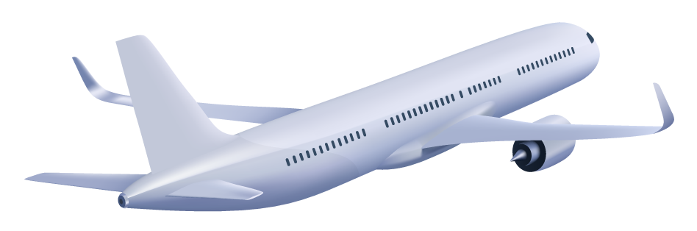
Business Impact

Slide 9
Business Impact
Less Congestion
Increased Online Baggage Purchases
Increase AA Loyalty Enrollment
Notes:
Travel Buddy has a wide Business Impact on the boarding process from start to finish. First our app attacks the current congestion issues at airports from several different angles. We provide a clear guide to a successful boarding process. This eliminates customers causing strain on resources at the airport with questions. We allow customers to scan their bags so they can see which bags are checked bags and which qualify as carry ons. This eliminates the ambiguity of what constitutes as a checked vs carry on thus reducing unnecessary traffic at ticketing booths. Next the app autofills how many checked bags were scanned and promotes customers to purchase the bag online and provides them with a qr code that makes the express kiosk even that much faster. Our app also has an explicit financial impact. We have trained a machine learning algorithim using Teradata apis to predict who is more likely to sign up for the AA program. This paired with presenting the sign up prompt as a pop up, which studies show has a 37% conversion rate, our app is designed to increase enrollment. Most Importantly Travel Buddy enriches customers’ experience with the on boarding process. Happy customers are loyal customers!

Slide 10
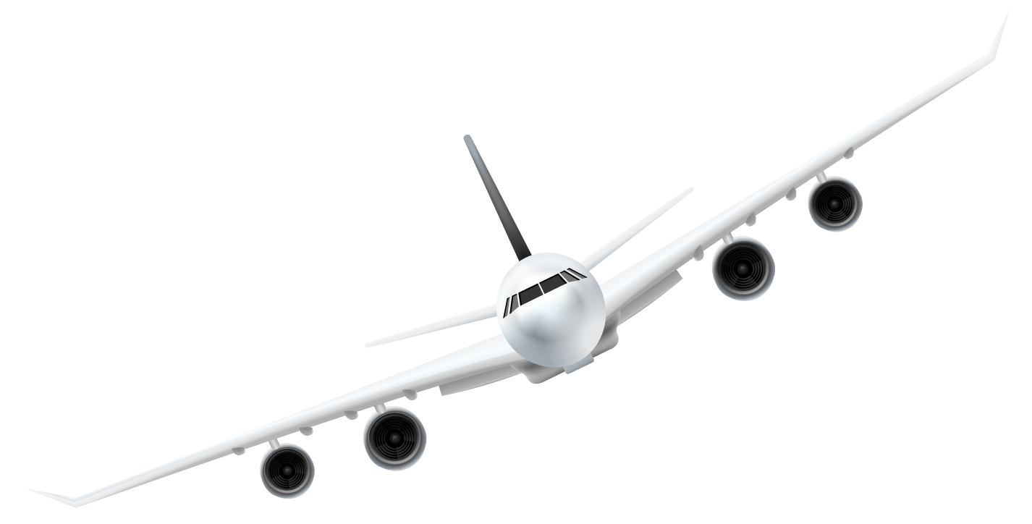
Future Works

Slide 11
Future Works
Improve Baggage Scanner
Accessibility
Notes:
Our Future Works include improving the baggage scanner model. The machine learning model that we leveraged in our app needs near perfect conditions to get accurate measurements. This is obviously not ideal, so if in the future we would like to improve the models performance. We would also like to make accessibility more of a priority in the app to allow more customers to have access to the app. One of our ideas to create a more accessible app would be to include voice assistance.

Slide 12
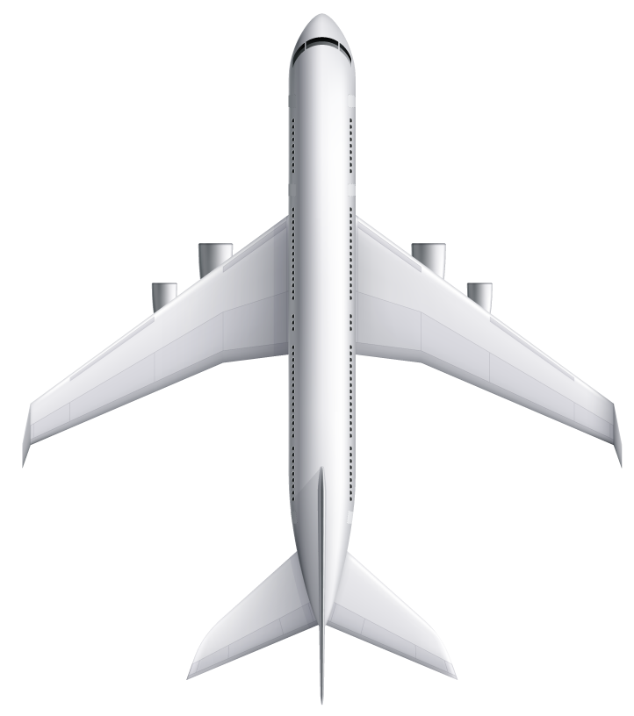
Thanks!
Do you have any questions?

